Slide 1
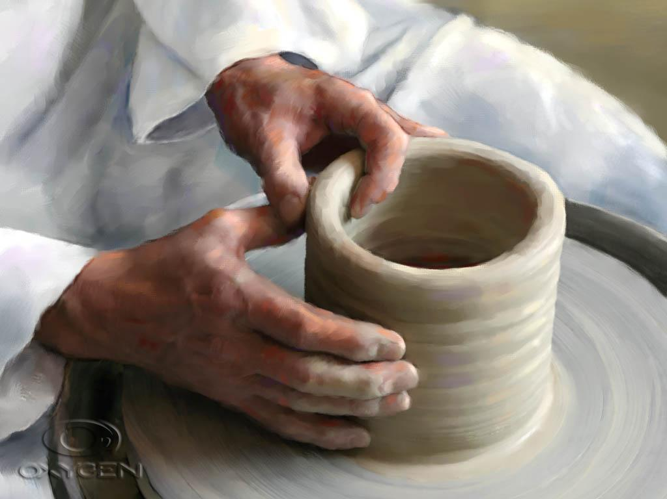
Be Formed
Exodus
Dr. Rick Griffith, Crossroads International Church Singapore
CICFamily.com • BibleStudyDownloads.org

Slide 2

Change is all around us.
Notes:
Change is all around us. You can’t avoid it. We see constant changes in our technology, attitudes, values, families and this church—our people, our programs and now our service time.

Slide 3
How is God forming us?
Notes:
I wonder how much the changes around us contribute to God forming us. How much of the changes in your life do you credit to God? Do you see what he is doing in your life? We often talk about God forming in us, though.

Slide 4
Why is God forming us?
Notes:
The real issue we don’t often discuss is this: Why is God forming us?

Slide 5
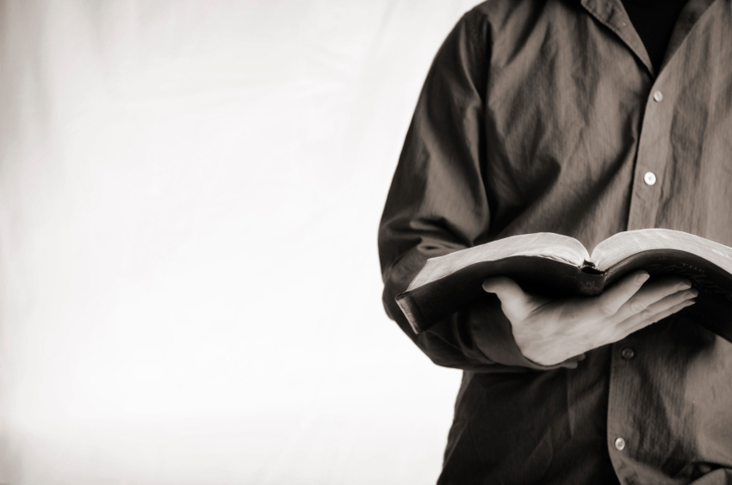
Let's Study Through Scripture
The Bible: Book by Book
Notes:
We are in a study through the whole Bible right now, book by book. The goal is to give us a basic understanding of each book of the Bible.

Slide 6

Wilderness Wanderings
Moab
Egypt
Kadesh- barnea
Mt. Sinai
Notes:
Moses wrote the first five books of the Bible after Israel had escaped Egypt. Yet they still needed to see why.

Slide 7
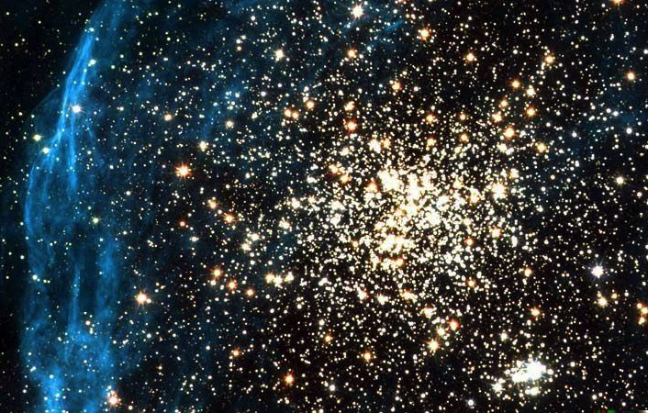
Key Word for Genesis:
56
Election
19
©2003 TBBMI
7.5.03a.
Notes:
Genesis told the original Jewiush audience in the wilderness that they were a unique, chosen people.

Slide 8


How can you be faithful to God in a world of idols?
IDOLS
of the
HEART
2 ways
Notes:
Genesis told the original audience coming from the idols of Egypt and heading to the idols of Canaan that they needed to be faithful to God. But how? Two ways!

Slide 9

Main Idea of Genesis
Live out God's choice of you and promises for blessing
Notes:
The key concepts of Genesis are choice and promise—said differently, election and covenant.
God chose Israel and covenanted with Abraham to make a great nation from him.

Slide 10
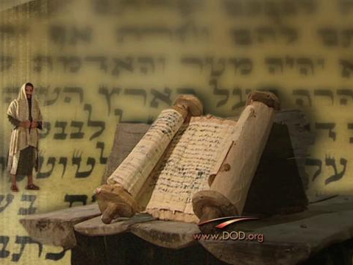
Background to Exodus
Notes:
So we have now come to Exodus. Who were the first readers of this book of Exodus that we’re studying?

Slide 11
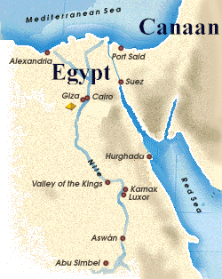
Joseph's Death
(the last verse of Genesis)
"So Joseph died at the age of a hundred and ten. And after they embalmed him, he was placed in a coffin in Egypt"
(50:26)
But what about God's promise of a land?
Notes:
Genesis ends with Jacob's large family in Egypt. Now in Exodus we see God making huge strides on his promise to form Jacob’s family into a country.

Slide 12
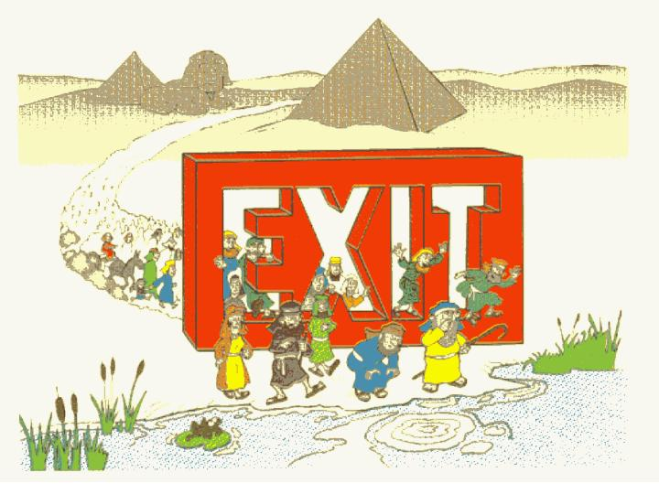
"Exit-us"
Walk Through The Bible ©1989

Slide 13
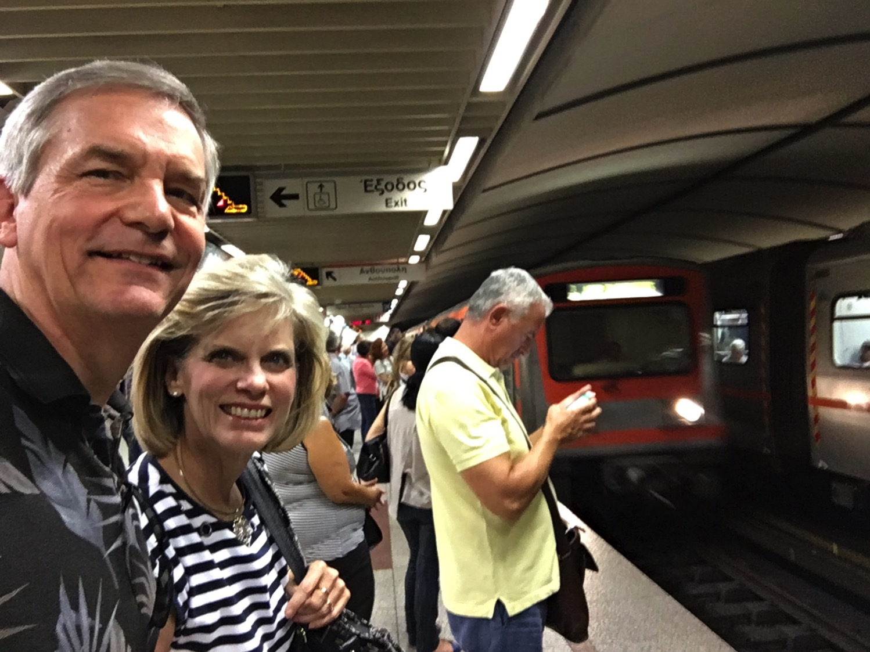
Visiting Corinth
Notes:
In September 2016 my wife Susan and I had the privilege to visit Corinth, Greece.

Slide 14
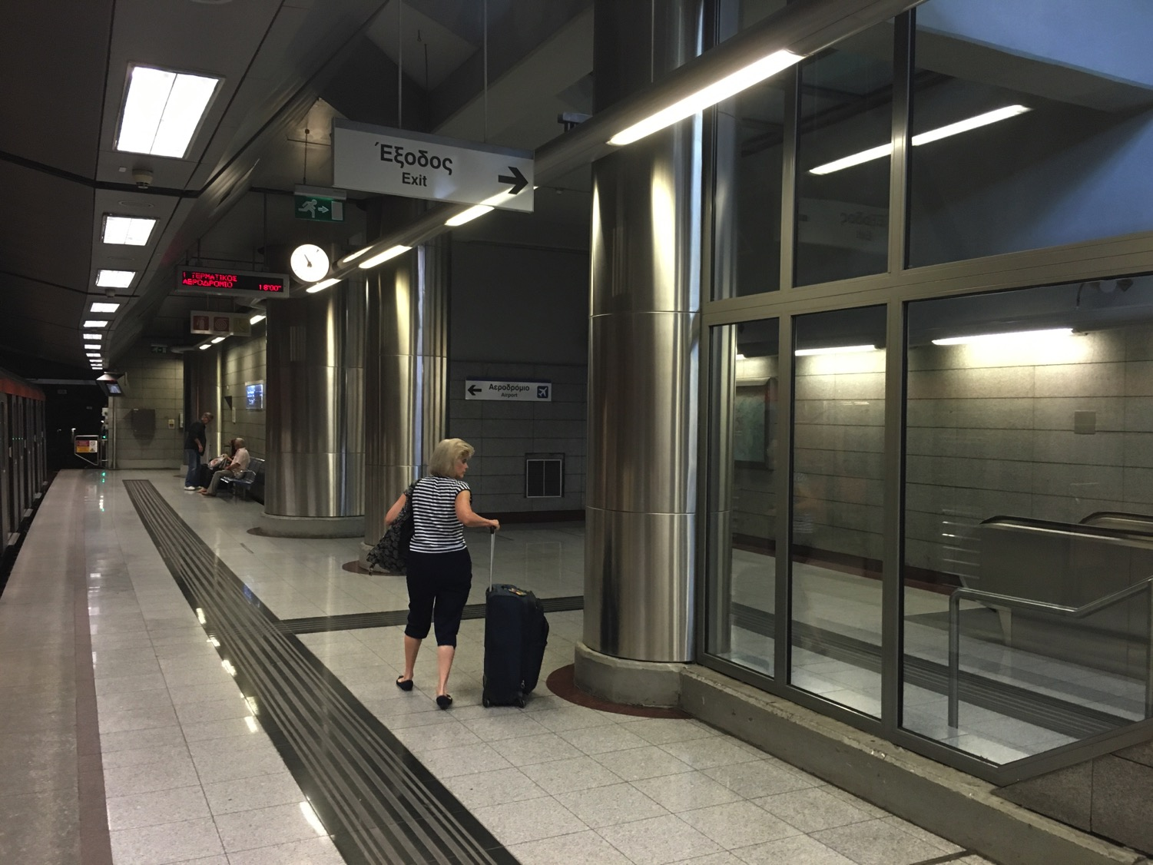
Directions?
Notes:
One of the challenges was managing the train system.

Slide 15
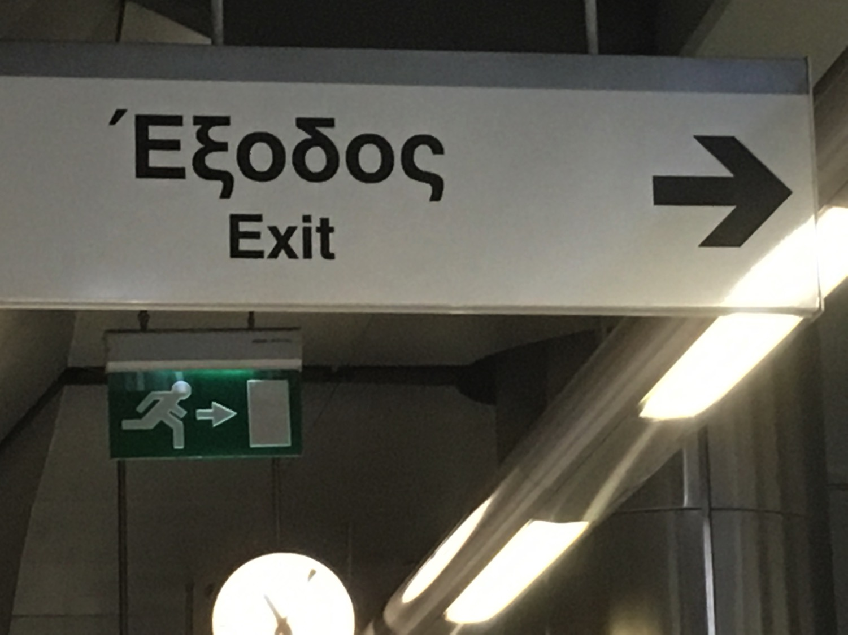
Way Out
Notes:
Fortunately, my three years of Greek in seminary came in handy, for the sign told us "Exodus," meaning "way out."
• OK, yes, it was in English too!

Slide 16
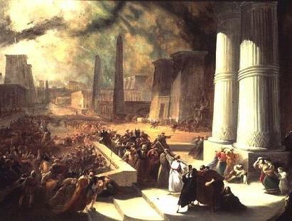
Title
99
The English title Exodus ("a going out") transliterates the Greek title Exodus, from e;k, "out," and o[doj, "way" = exit, departure, or going out.
Israel's leaving Egypt takes only a few chapters, but this key emphasis in the book makes "Exodus" a fitting title.
The English title Exodus ("a going out") transliterates the Greek title Exodus, from ek, "out," and hodos, "way" = exit, departure, or going out.
Israel's leaving Egypt takes only a few chapters, but this key emphasis in the book makes "Exodus" a fitting title.
The English title Exodus ("a going out") transliterates the Greek title Exodus, from e;k, "out," and o[doj, "way" = exit, departure, or going out.
Israel's leaving Egypt takes only a few chapters, but this key emphasis in the book makes "Exodus" a fitting title.

Slide 17
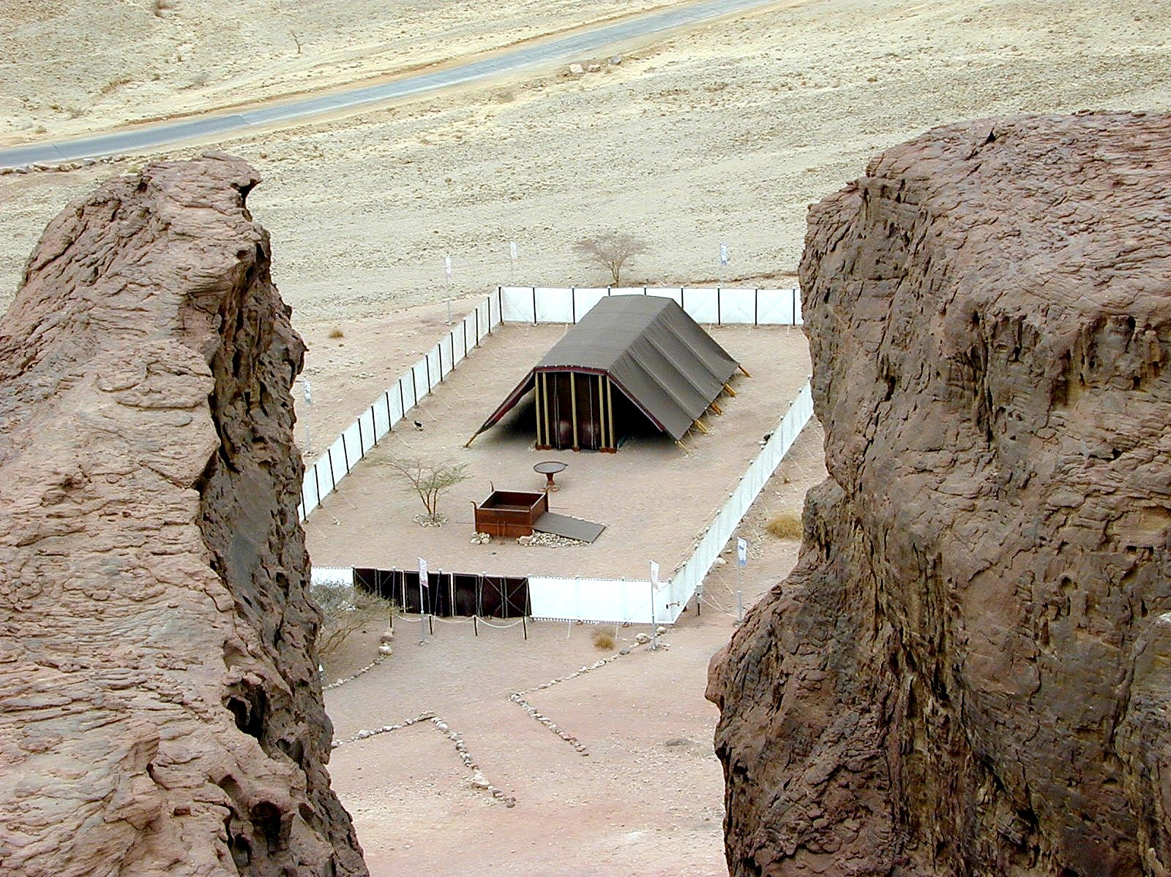
Key Word
98
Formation

Slide 18

What does it take to form a nation?
100

Slide 19
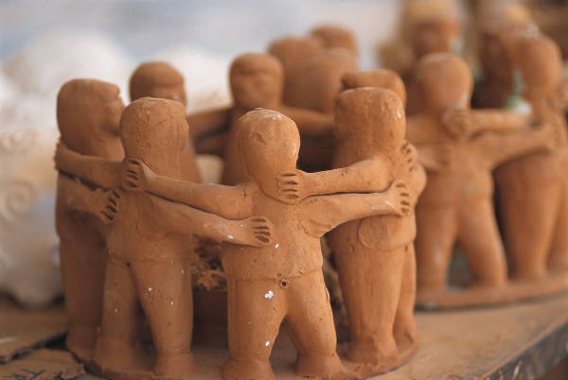
Argument
100
To become a nation Israel needed three things:
(1) freedom
(2) government
(3) land
Exodus records the first two of these three needs.
The only national characteristic lacking is a land, which is secured in the Book of Joshua.

Slide 20

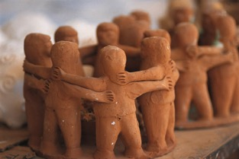
Exodus Chart
98
Formation into a Nation Begun
Chapters 1–18
Chapters 19–40
Receive Freedom from Slavery
Receive Law from God
Getting Israel Out of Egypt
Getting Egypt Out of Israel
Narration
Legislation
Free People
Government
Subjection
Deliverance
Instruction
Egypt
Wilderness
Sinai
400 Years
2 Months
10 Months
Toil & Confrontation
(1–11)
Redemption & Protection
(12–18)
Covenant Revealed
(19–31)
Covenant Ratified
(32–40)
Moses as
Returned Fugitive
Moses as
Wilderness Leader
Moses as
Intermediary
Moses as
Lawgiver
Preparation
(1:1–7:13)
Plagues
(7:14–11:10)
Memorials
(12:1–15:21)
Provisions
(15:22–18:27)
Preparation
(19)
3-Part Covenant
(20–31)
Broken &
Renewed
(32–34)
Tabernacle
Built/Filled
(35–40)

Slide 21
Key Exodus Sections
Exodus
Law
Tabernacle
1–18
19–31
32–40
Narrative
Instruction

Slide 22
Why is God forming us?
2 reasons

Slide 23
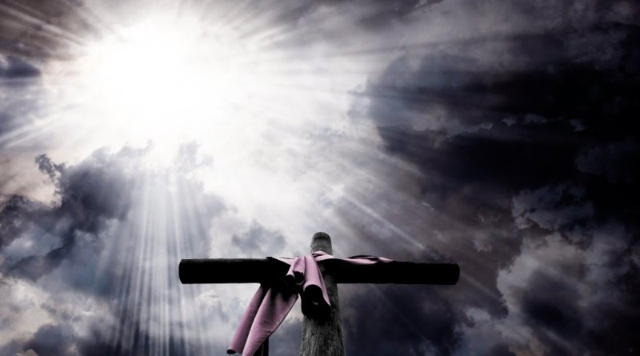
I. God saves us to show his power and care.
Exodus 1–18
Notes:
He forms us by delivering us to display his sovereignty and concern.

Slide 24
Key Exodus Sections
Exodus
God saved Israel from slavery in Egypt
and protected them in the wilderness.
1–18
Narrative

Slide 25
1. God used Moses to urge Pharaoh to free Israel from slavery to show that:
The Point of Exodus 1–11
• the LORD cared,
• was faithful to the Abrahamic Covenant, and
• was sovereign over Egypt’s gods.

Slide 26
Slides on
Exodus 1

Slide 27
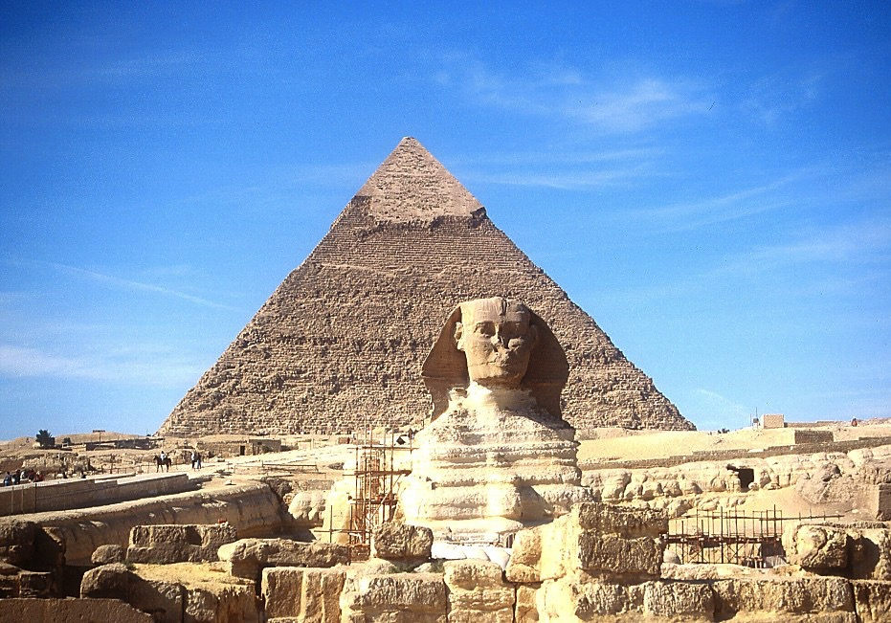
The Sphinx and the Great Pyramid
7
JOSEPH
Handbook pg. 24-25
57

Slide 28
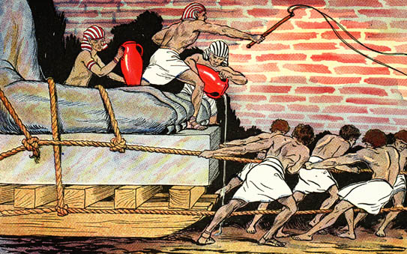
Egyptians Ruthlessly Oppressed Israel

Slide 29
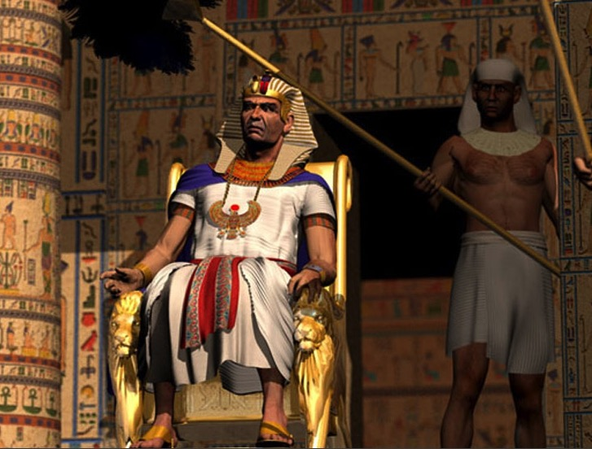
"Ultimate" Power

Slide 30
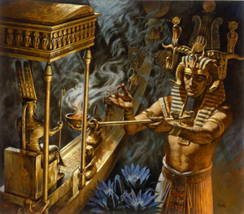
Who has greater power – Pharaoh or Yahweh?

Slide 31
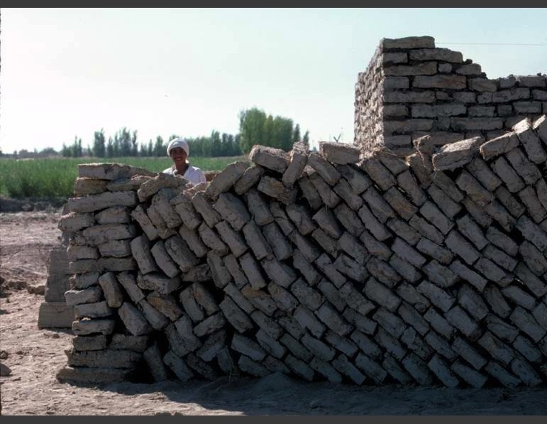
Mud Bricks

Slide 32
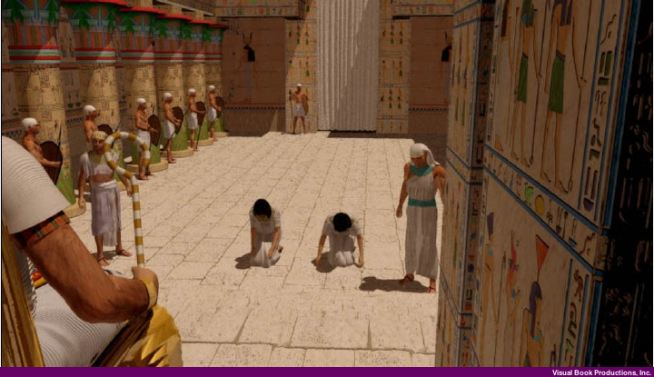
Hebrew Midwives appear before Pharaoh (Exodus 1:15-22)

Slide 33
Slides on
Exodus 2

Slide 34
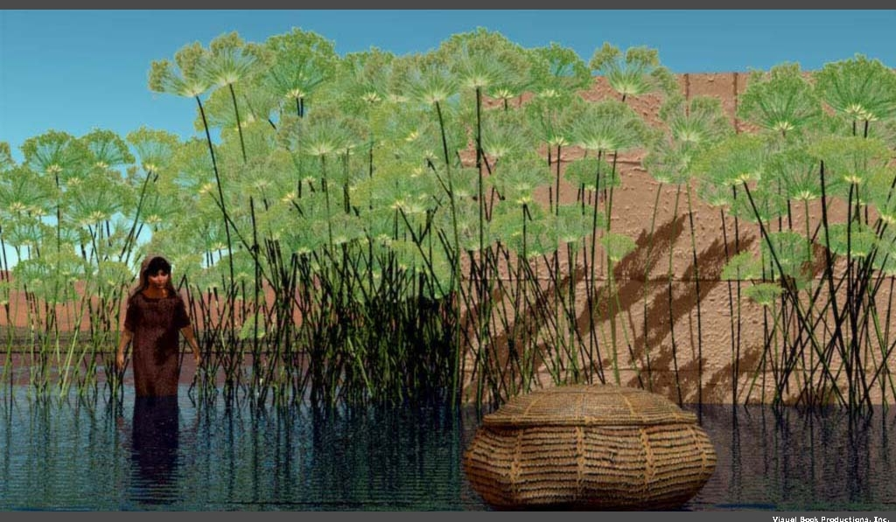
Moses was "thrown into the Nile" (Exod. 1:22)

Slide 35
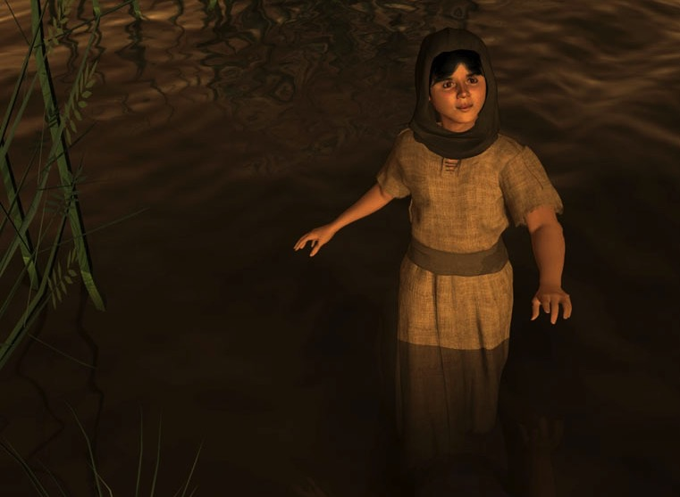
Miriam (Exod. 2:4)

Slide 36
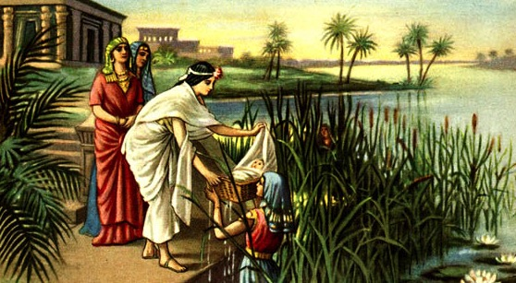
Acts 7:20-21 (NIV)
"At that time Moses was born, and he was no ordinary child. For three months he was cared for in his father's house. When he was placed outside, Pharaoh's daughter took him and brought him up as her own son."

Slide 37
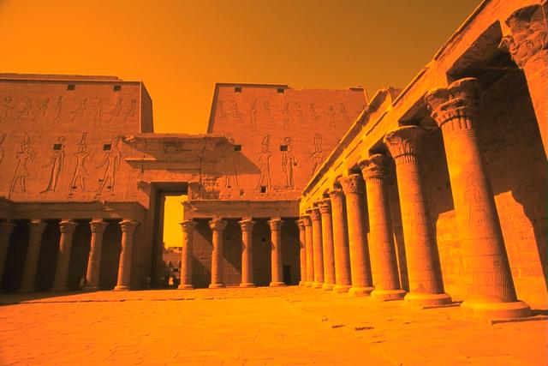
Acts 7:22 (NIV)
"Moses was educated in all the wisdom of the Egyptians and was powerful in speech and action."

Slide 38

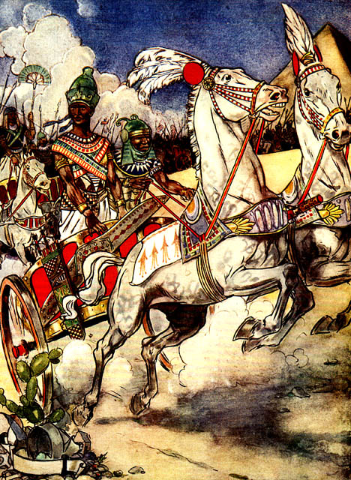
Moses Flees
Thutmose III

Slide 39
Location of Midian
Canaan
Goshen
Nile River
Mt. Sinai
Egypt
Midian

Slide 40
Slides on
Exodus 3

Slide 41
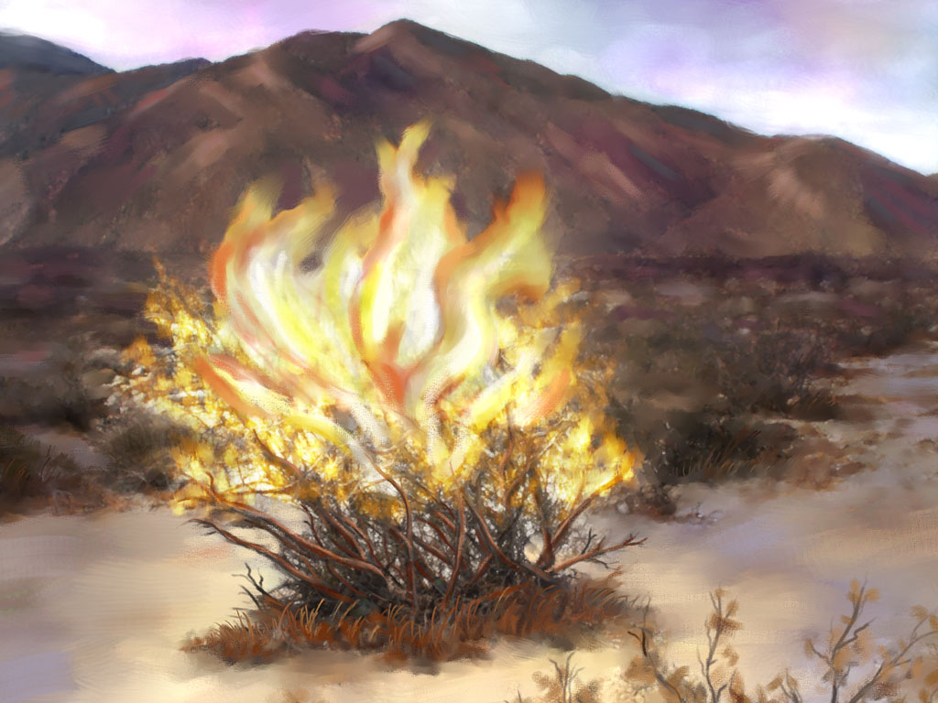
God calls His servant
(Exod. 3)

Slide 42
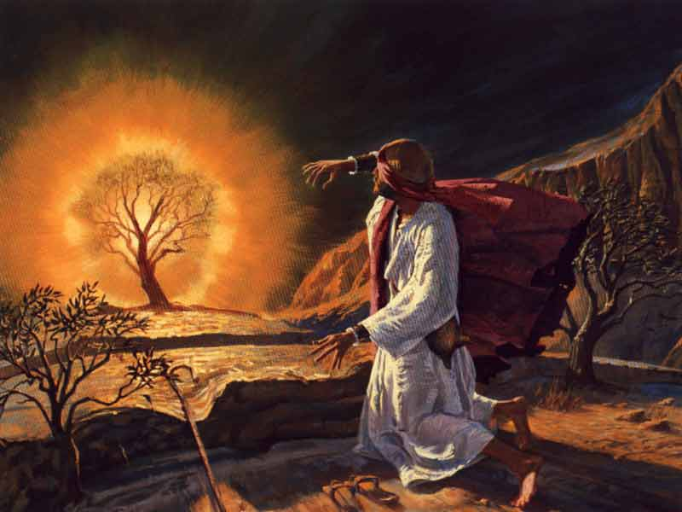
The Burning Bush
(Exod. 3:1–4:17)

Slide 43
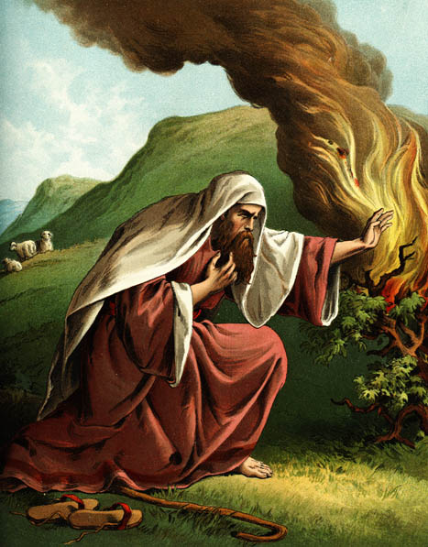
EXCUSES
1. Who am I (3:11)?
"God replied to Moses, 'I Am Who
I Am. Say this to the people of Israel:
I Am has sent me to you'"
(Exodus 3:14 NLT).
2. Who are You (3:13)?
3. What if I fail (4:1)?
4. I'm not gifted (4:10)
5. I don't want to get involved (4:13)

Slide 44
Slides on
Exodus 4

Slide 45
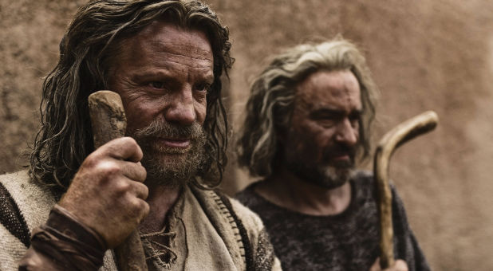
The conversation between Moses and God ended only after Aaron's appointment as ministry partner
(Exod. 4:13-17)

Slide 46
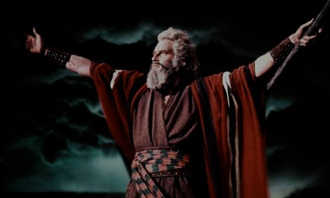
Moses' Life
100
Period
Reference
Dates
Location
40 years Prince
Exod. 2:1-10
1525-1485 BC
Egypt
(Academic)
40 years Shepherd
Exod. 2:11-25
1485-1445 BC
Midian
(Field Ed.)
40 years Leader
Exod. 3:1– Deut. 34:8
1445-1405 BC
Midian Egypt Wilderness

Slide 47
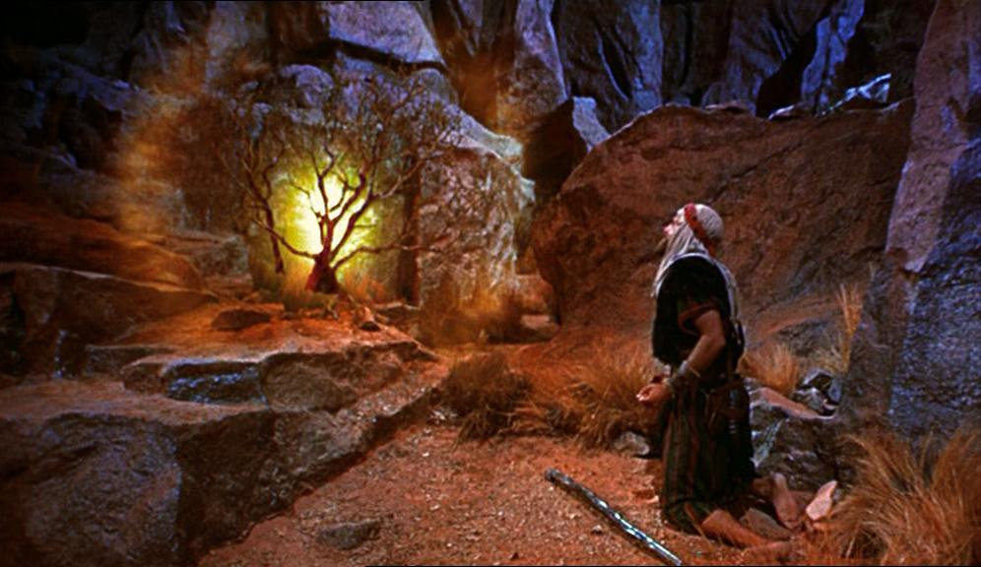
God's servant who understands his own inadequacy will show God's sufficiency (Exod. 3–4)

Slide 48
Slides on
Exodus 7

Slide 49
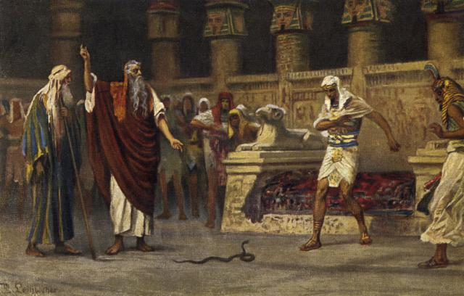
"So Moses and Aaron went to Pharaoh and did what the LORD had commanded them. Aaron threw down his staff before Pharaoh and his officials, and it became a serpent!" (Exodus 7:10 NLT).

Slide 50
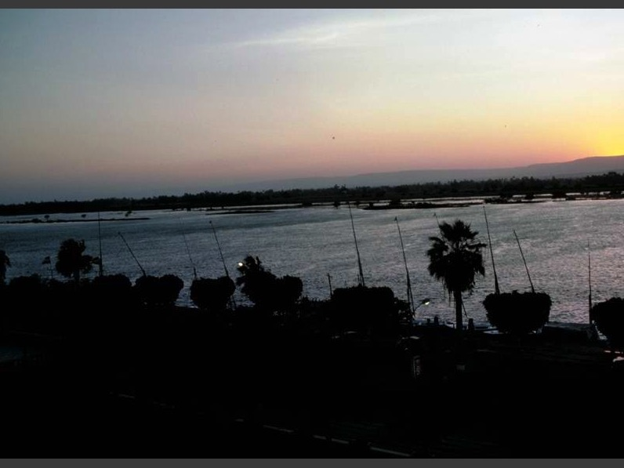
10 PLAGUES
Blood
Frogs
Gnats
Flies
Livestock
Boils
Hail
Locusts
Darkness
Firstborn
Exodus 7-12

Slide 51
Slides on
Exodus 12

Slide 52
2. God redeemed Israel from Egypt and protected them in the desert to show:
The Point of Exodus 12–18
• his sovereignty,
• his ability, and
• his care for the nation until she had her own land.

Slide 53
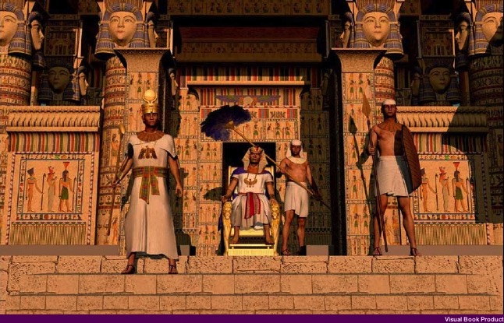
Meaning of Plagues
"On that same night I will pass through Egypt and strike down every firstborn—both men and animals—
and I will bring judgment on all the gods of Egypt. I am the LORD."
Exodus 12:12 (NIV)

Slide 54
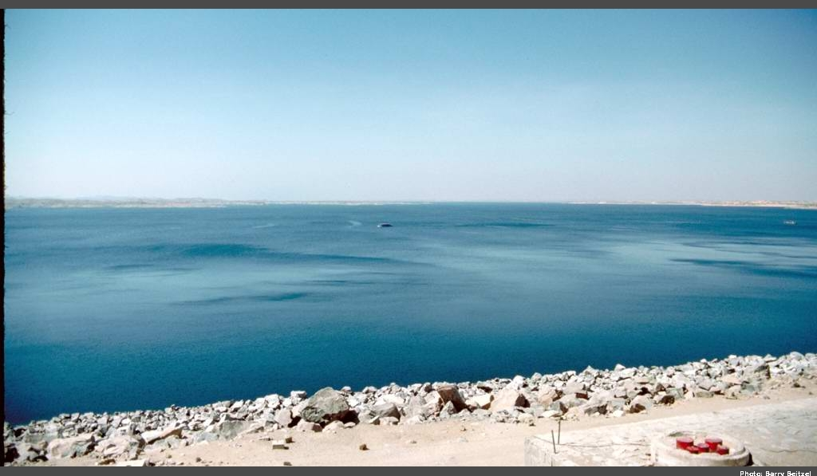
Recalling the Exodus Significance
"The Israelites set out from Rameses on the fifteenth day of the first month, the day after the Passover. They marched out boldly in full view of all the Egyptians, who were burying all their firstborn, whom the LORD had struck down among them…"
Numbers 33:3-4a (NIV)

Slide 55
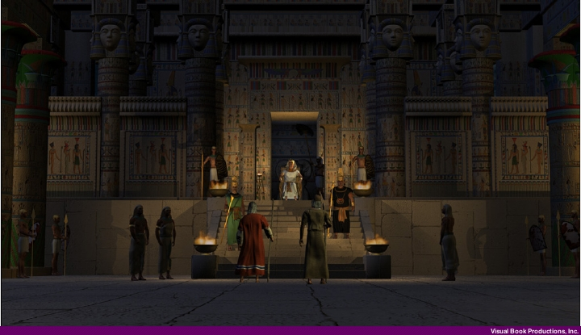
Recalling the Exodus Significance
"…for the LORD had brought judgment on their gods."
Numbers 33:4b (NIV)

Slide 56
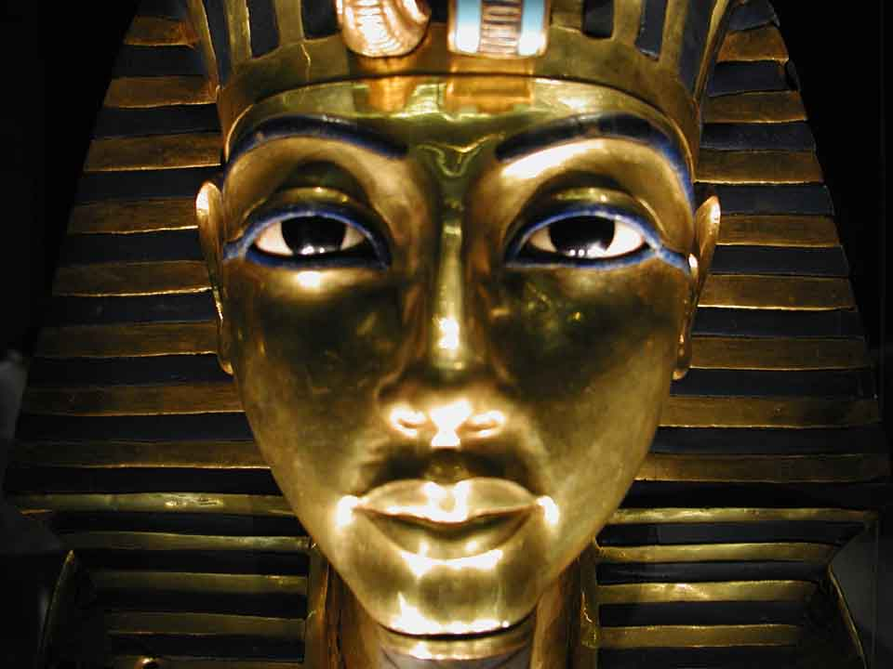
The Plagues and the Gods of Egypt
John H. Walton, Chronological and Background Charts of the OT, 2d ed., 85, adapted
106
PLAGUE
REFERENCE
POSSIBLE EGYPTIAN DEITY DIRECTED AGAINST
NILE TURNED TO BLOOD
Exodus
7:14-25
Khnum: guardian of the Nile
Hapi: spirit of the Nile
Osiris: Nile was bloodstream
FROGS
Exodus
8:1-1.5
Heqt: form of frog; god of resurrection
GNATS
(MOSQUITOES)
Exodus
8:16-19
Set: god of desert or earth
FLIES
Exodus
8:20-32
Re, a sun god (or possibly the god Uatchit, possibly represented by the fly)
PLAGUE ON CATTLE
Exodus 9:1-7
Hathor: mother-goddess; form of cow
Apis: bull of god Ptah; symbol of fertility
Mnevis: sacred bull of Heliopolis

Slide 57
The Plagues and the Gods of Egypt
John H. Walton, Chronological and Background Charts of the OT, 2d ed., 85, adapted
106
PLAGUE
REFERENCE
POSSIBLE EGYPTIAN DEITY DIRECTED AGAINST
BOILS
Exodus 9:5-12
Imhotep: god of medicine
HAIL
Exodus
9:13-35
Nut: sky goddess
Isis: goddess of life
Seth: protector of crops
LOCUSTS
Exodus l0:1-20
Isis: goddess of life
Seth: protector of crops
DARKNESS
Exodus
10:21-29
Re, Aten, Atum, Horus: all sun gods of sorts
DEATH OF FIRSTBORN
Exodus
11:1-12:36
The deity of Pharaoh: Osiris, the giver of life

Slide 58
Route of the Exodus
Canaan
107
Goshen
Nile River
Mt. Sinai
Egypt
Midian

Slide 59
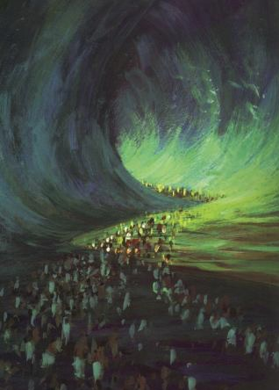
Crossing the Sea of Reeds
Yam Suph (Exod. 13:18; cf. 10:19) means "Sea of Reeds" but was erroneously translated as "Red Sea" in the LXX.
Amenophis II

Slide 60
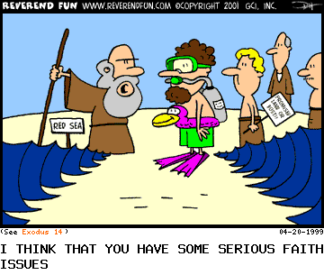
The Exodus Took Faith!
I think you have some serious faith issues.

Slide 61
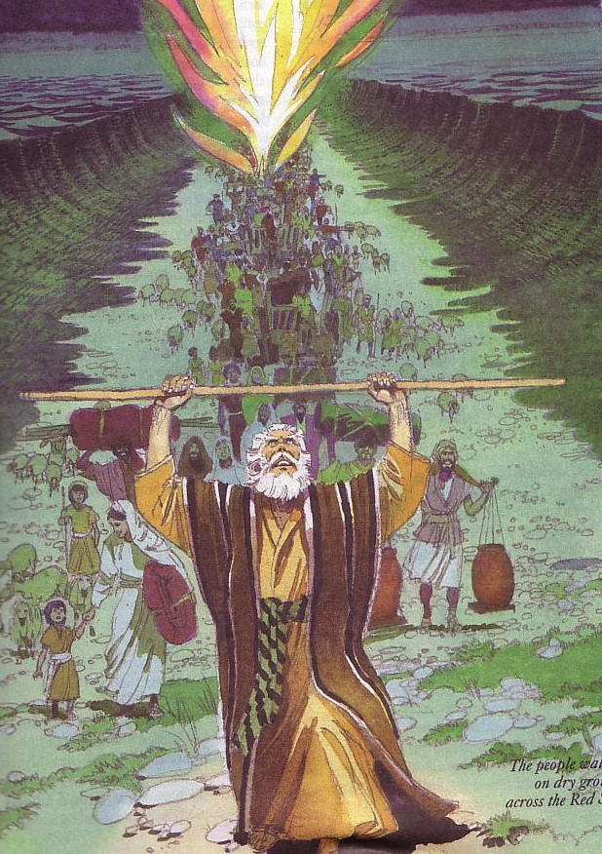
Why is the Exodus so significant?
God is more powerful than Egypt's gods (12:29, 37)!
God fulfilled his promise to the day (12:40-41;
cf. Gen. 15:15)
Typology of Passover lamb (12:3-5, 27, 43,
46; cf. John 1:29; 19:36; 1 Cor. 5:7-8)

Slide 62

Hebrew Calendars
The Exodus Night:
While the Israelites were still in the land of Egypt, the LORD gave the following instructions to Moses and Aaron: ²"From now on, this month will be the first month of the year for you" (Exod. 12:1-2)
134
221
1 Nisan
2 Iyar
3 Sivan
4 Tammuz
5 Av
6 Elul
7 Tishri
8 Cheshvan
9 Kislev
10 Tevet
11 Shevat
12 Adar
Mar-Apr
Sacred Calendar Begins
Civil Calendar Begins
Sep-Oct

Slide 63
Slides on
Exodus 13

Slide 64
Why is the Exodus so significant?
Beginning of the nation (6:6-8)
New calendar (12:2)
Response of faith to receive new life

Slide 65
Slides on
Exodus 14

Slide 66
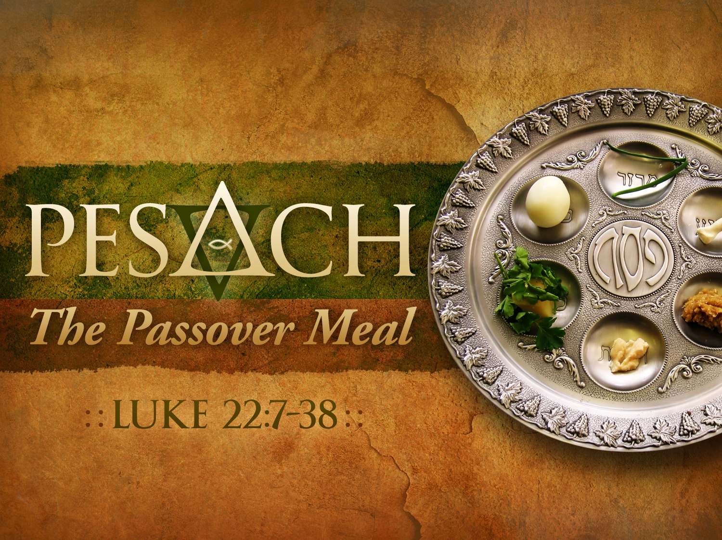
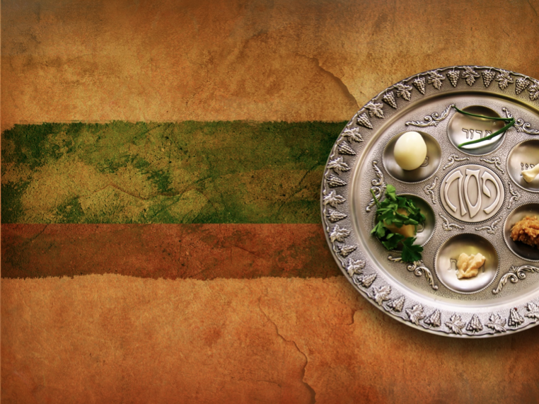
PESACH
The Passover Meal
LUKE 22:7-38
Notes:
Translators, please drag the wording and image on the right over the above image and text and then translate them.

Slide 67
Slides on
Exodus 16

Slide 68
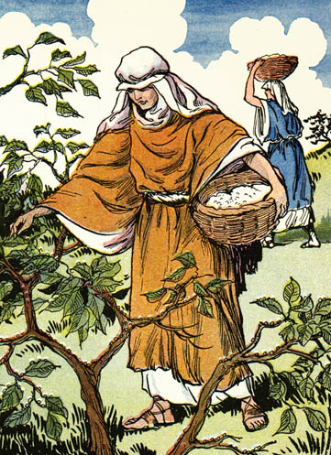
Manna
(Exod 16)

Slide 69
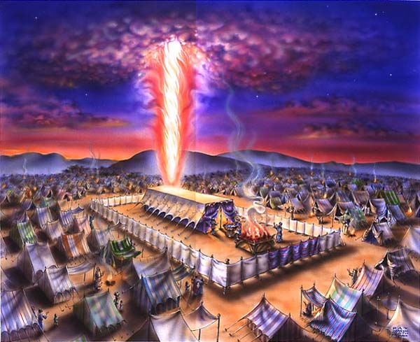
The Cloud
Exodus 40;
1 Cor. 10:1-4

Slide 70


The Sea
Exodus 40;
1 Cor. 10:1-4

Slide 71

The Leader
Exodus 40;
1 Cor. 10:1-4

Slide 72
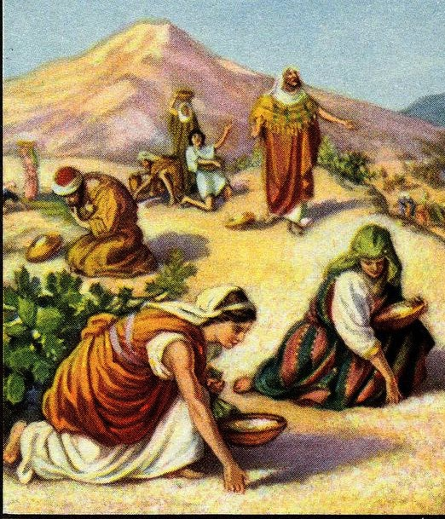
The Food
Exodus 40;
1 Cor. 10:1-4

Slide 73
Slides on
Exodus 17

Slide 74
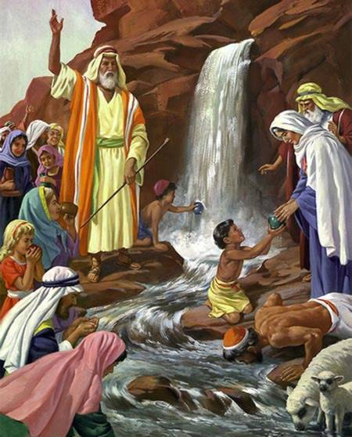
The Water
Exodus 40;
1 Cor. 10:1-4

Slide 75
Slides on
Exodus 18

Slide 76
Traditional Route of the Exodus
Canaan
107
Goshen
Nile River
Mt. Sinai
Egypt
Midian

Slide 77

Jesus is our New Exodus who delivers us from sin as our Passover Lamb—and this shows his power and care.

Slide 78
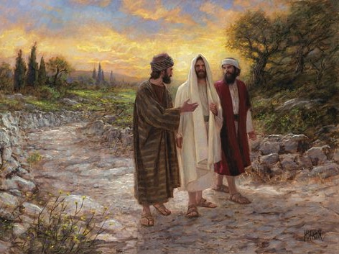
Could mortals and those in glorified bodies really live together?
"And beginning with Moses and all the Prophets, he explained to them what was said in all the Scriptures concerning himself"
(Luke 24:27 NIV)

Slide 79


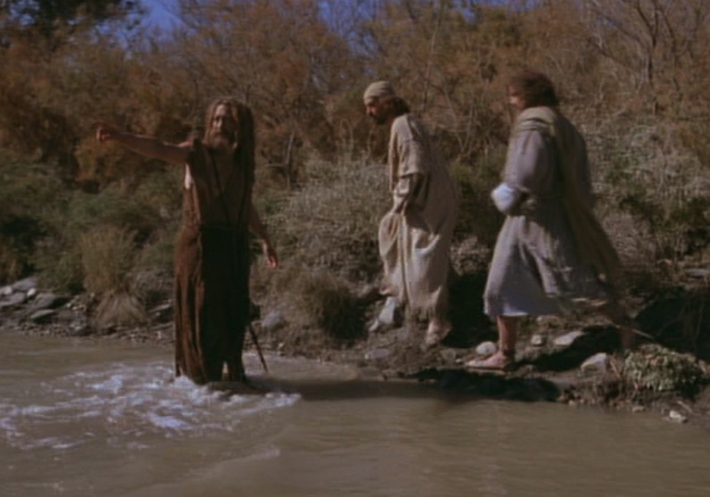
The Passover Lamb
"Look, the Lamb of God,
who takes away
the sin of the world!"
(John 1:29)

Slide 80

Passover Protection
"The blood will be a sign for you on the houses where you are; and when I see the blood, I will pass over you. No destructive plague will touch you when I strike Egypt."
Exodus 12:13 (NIV)

Slide 81
Faith Pictured
"By faith he kept the Passover and the sprinkling of blood, so that the destroyer of the firstborn would not touch the firstborn of Israel."
Hebrews 11:28 (NIV)

Slide 82
The Lamb Pictured
"The next day John saw Jesus coming toward him and said, 'Look, the Lamb of God, who takes away the sin of the world!'"
John 1:29 (NIV)

Slide 83
The Cross Pictured
"For Christ, our Passover lamb, has been sacrificed."
1 Corinthians 5:7 (NIV)

Slide 84

Faith in a Lamb

Slide 85

"This is my body…"

Slide 86

Exodus 12:1-16
The Angel of Death Passed Over Houses with Blood on the Doors
Thus says the LORD, "About midnight I will go out in the midst of Egypt" (Exod. 11:4)

Slide 87
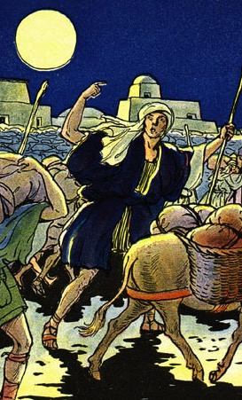
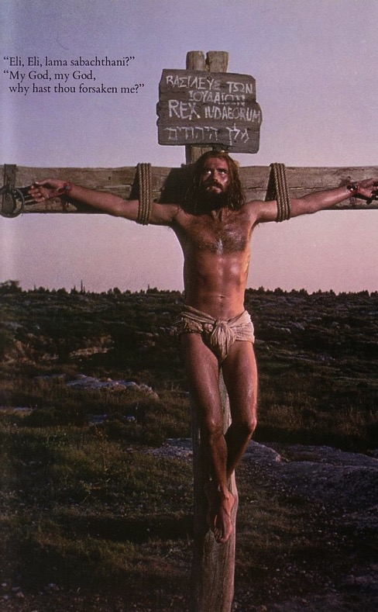
The Common Thread
What the Exodus is to the Old Testament…
the cross of Christ is to the New Testament
Deliverance!

Slide 88



The Exodus Pictures Redemption
"For he has rescued us from the dominion of darkness and brought us into the kingdom of the Son he loves, in whom we have redemption, the forgiveness of sins."
Colossians 1:13-14 (NIV)

Slide 89

1 Corinthians 10:1-4 (NLT)
"I don't want you to forget, dear brothers and sisters, about our ancestors in the wilderness long ago. All of them were guided by a cloud that moved ahead of them, and all of them walked through the sea on dry ground. ²In the cloud and in the sea, all of them were baptized as followers of Moses. ³All of them ate the same spiritual food, ⁴and all of them drank the same spiritual water. For they drank from the spiritual rock that traveled with them, and that rock was Christ."

Slide 90
Why is God forming us?
2 reasons

Slide 91
I. God saves us to show his power and care.
Exodus 1–18
Notes:
He forms us by delivering us to display his sovereignty and concern.

Slide 92

II. God teaches us as his new people to enjoy his presence.
Exodus 19–40
Notes:
He forms us by instructing us to witness of his dwelling with us!

Slide 93
Key Exodus Sections
Exodus
God saved Israel from slavery in Egypt
and protected them in the wilderness.
1–18
Narrative

Slide 94
Key Exodus Sections
God taught Israel the Mosaic Law so he could live with them in the tabernacle
Law
Tabernacle
19–31
32–40
Instruction

Slide 95
1. God gave the Law to start Israel's covenant relationship with a holy God.
The Point of Exodus 19–31

Slide 96

Why was the Law so vital?
The Law gave Israel a governmental charter

Slide 97
Slides on
Exodus 19

Slide 98


Moses became covenant mediator
Exodus 19–40

Slide 99
Key Verse
98
"Now if you obey me fully and keep my covenant, then out of all nations you will be my treasured possession. Although the whole earth is mine, you will be for me a kingdom of priests and a holy nation"
(Exodus 19:5-6)

Slide 100
Summary Statement
Exodus
98
Israel's formation as a nation begins under God as King by a miraculous redemption from Egypt and revelation of the Mosaic Law to provide a kingdom over which a descendant of Judah could rule and to promote holiness and trust in God.

Slide 101
Slides on
Exodus 20

Slide 102

The Big Ten

Slide 103
Slides on
Exodus 21

Slide 104

The heart of the Mosaic Covenant is the Ten Commandments

Slide 105
Slides on
Exodus 23

Slide 106


Contrasting Two Key Covenants
116
 | Abrahamic | Mosaic
Recipient (Date & Place) | Abraham as mediator for all nations in 2060 BC at Ur of the Chaldees | Moses as mediator for Israel in 1445 BC at Mount Sinai
Scripture | Genesis 12:1-3 (but formalized into a covenant in Genesis 15) | Exodus 20–31 is the heart of the covenant
Between God & | A person (for a future nation) | A nation
Scope | Universal ("all peoples will be blessed through you") | Only Israel received the Law (Deut. 4:8; Ps. 147:20)

Slide 107
Contrasting Two Key Covenants
116
 | Abrahamic | Mosaic
Promises | Land, seed, and blessing (without indication of time of fulfillment) | Blessing for obedience and cursing for disobedience (Lev. 26; Deut. 28)
Conditions | Unconditional: "I will…" | Conditional: "If you will…then I will…"
Partici-pation | Abraham asleep (Gen. 15:17) | Israel agreed to obey (Exod. 19:8)
Analogy | Father to son (royal grant) | Suzerain (superior king) to vassal (servant nation)

Slide 108
Contrasting Two Key Covenants
116
 | Abrahamic | Mosaic
Form | Oral (no written stipulations) | Written on tablets of stone & Pentateuch
Emphasis | Blessing over discipline/judgment (five "blessings" in Gen. 12:1-3) | Judgment/discipline over blessing (contrast Deut. 28:1-14 & 28:15-68)
Christ | Ultimate seed (Gen. 12:3) | Typified in tabernacle (Heb. 8–10)
Sign | Circumcision (Gen. 17:11) | Sabbath (Exod. 31:13, 17)

Slide 109
Slides on
Exodus 25

Slide 110

The Tabernacle

Slide 111


Ark of the Covenant
119

Slide 112





The Furnishings
119a
Brazen Altar
Laver
Altar of Incense
Lampstand
Showbread

Slide 113

Tabernacle prefiguring the Cross
Notes:
"The Table of Showbread.
This reminds us of Christ who is "the Bread of life." We must feed on Him daily.
The Golden Candlestick.
This speaks of Christ as "the Light of the world."
The Golden Altar.
This points to Christ as the One by whom we have access to God in prayer.
The Ark.
This speaks of Christ's Person and His work. The lid of "Mercy Seat" of the ark was where the blood of the sin offering was sprinkled. God said, "There will I meet with you, and I will commune with you from above the mercy seat...." (Exodus 25:22)."
Copyright © 1998-2015 UB David & I'll B Jonathan, Inc.
Mailbox Club lessons © The Mailbox Club International;
used by permission with adaptation for the Internet.
All rights reserved.
http://ubdavid.org/bibleexploration/light-old-testament/light-old-testament_8-1.html

Slide 114

Tabernacle prefiguring the Cross
Notes:
"Now look at the diagram. We see that the position of the furniture in the courtyard and in the Tabernacle formed a cross. Was this just chance? No! God told Moses exactly where every piece of furniture should be."
Copyright © 1998-2015 UB David & I'll B Jonathan, Inc.
Mailbox Club lessons © The Mailbox Club International;
used by permission with adaptation for the Internet.
All rights reserved.
http://ubdavid.org/bibleexploration/light-old-testament/light-old-testament_8-1.html

Slide 115

God sets up a place for Him to dwell as King
7
The Tabernacle
MOSES
Exodus
Sinai
M - C - C
Kadesh Barnea
40
The Tabernacle in the Wilderness
Handbook pg. 26-29
2
16
Notes:
Both Jews and pagans viewed the temple not so much as the place where a deity was worshipped, but rather the place where the deity dwelt. These were in fact palaces of their divine king, although Solomon acknowledged that no "house" (beth) could contain God Himself (1 Kings 8:27). Interestingly, the Hebrew word hêcãl (lk'yhe) means either "temple" or "palace" (BDB 228a).
The same word hêcãl is translated as the palace of God or "house of God," such as Solomon's temple (1 Kings 6:17)–which included the bet or holy place as distinguished from the inner sanctuary (1 Kings 6:1-2). Interestingly, though God's presence resided in the Holy of Holies, it was the holy place that was deemed the palace of the LORD. Jesus called the temple his "Father's house" (Luke 2:49; John 2:16).
Infrequently it referred to the palace of Ahab (1 Kings 21:1) or of the king of Babylon (2 Kings 20:18 = Isa. 39:17; 2 Chron. 36:7; Dan. 1:4) or other pagan palaces such as those at Nineveh (Nahum 2:7).
Likewise, "tabernacle" (mishkan) means "tabernacle, dwelling" also emphasizes that God was living with them.

Slide 116
Slides on
Exodus 28

Slide 117


Garments of the High Priest
119c
Turban (gold plate over forehead)
Tunic (white fine linen shirt)
Undergarments (linen from waist to thigh)
Robe (blue with bells & pomegranates)
Ephod (gold, blue, and purple with onyx stones)
Sash (belt to hold the garments together)
Breastpiece (chestpiece)
Urim & Thummin
Exodus 28

Slide 118

High Priest Breastpiece
(Exod. 28:15-21 NIV)

Slide 119
2. Israel built the tabernacle where God dwelt as King.
The Point of Exodus 32–40

Slide 120
Slides on
Exodus 32

Slide 121

The Golden Calf Incident
Exodus 32

Slide 122

Tablets Smashed
Exodus 32:19

Slide 123
Slides on
Exodus 35

Slide 124

The Tabernacle of Israel
The Tabernacle is Built

Slide 125
Slides on
Exodus 40

Slide 126


God's presence filled his new palace!
Then the cloud covered the tent of meeting, and the glory of the LORD filled the tabernacle.
Exodus 40:34 ESV

Slide 127

Jesus brings us into a new covenant where he indwells us with his Spirit

Slide 128

God's Presence Indwelt Solomon's Temple

Slide 129

What happened at Pentecost?

Slide 130


The Indwelling Spirit

Slide 131
Why is God forming us?
2 reasons

Slide 132
I. God saves us to show his power and care.
Exodus 1–18
Notes:
He forms us by delivering us to display his sovereignty and concern.

Slide 133
II. God teaches us as his new people to enjoy his presence.
Exodus 19–40
Notes:
He forms us by instructing us to witness of his dwelling with us!

Slide 134

Main Idea
God saved you to enjoy his presence
Exodus

Slide 135
What are we supposed to do about God forming us?

Slide 136
Do you relate to Jesus as your compassionate, High Priest?
JESUS > RELIGION

Slide 137

Relationship, not rituals

Slide 138
Black

Slide 139


Bible Exposition link at BibleStudyDownloads.org
Get this presentation and script for free!

